Slide 1
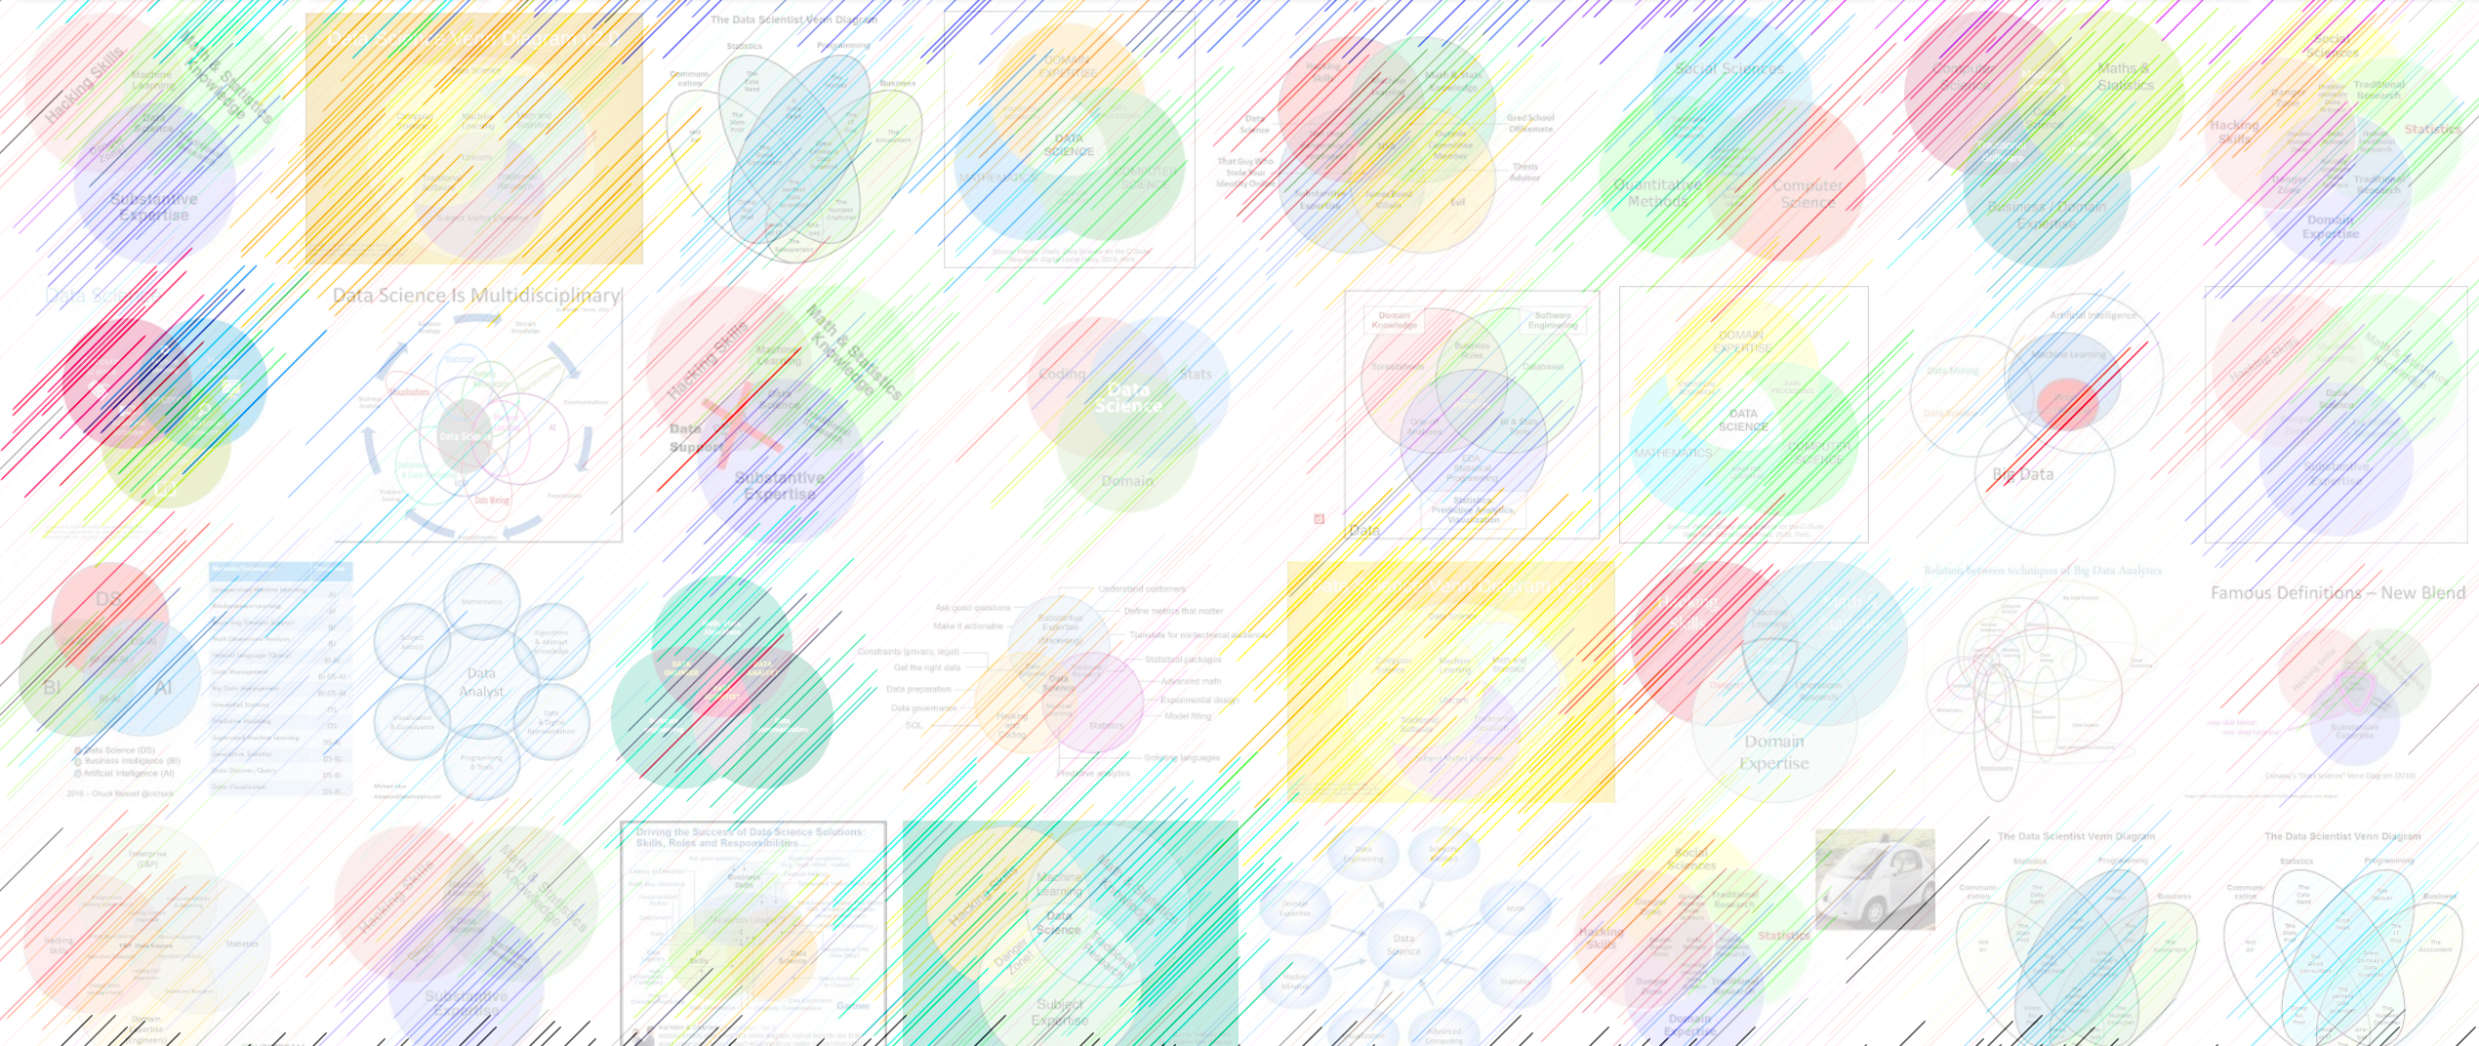

DATA221 Intro Machine Learning 02 objective function
William Trimble
Spring 2023

Slide 2

Caught in the wild!
And for the noble, purpose allowing salespeople to send spam with fewer constraints!
https://www.npr.org/2022/03/27/1088140809/fake-linkedin-profiles

Slide 3
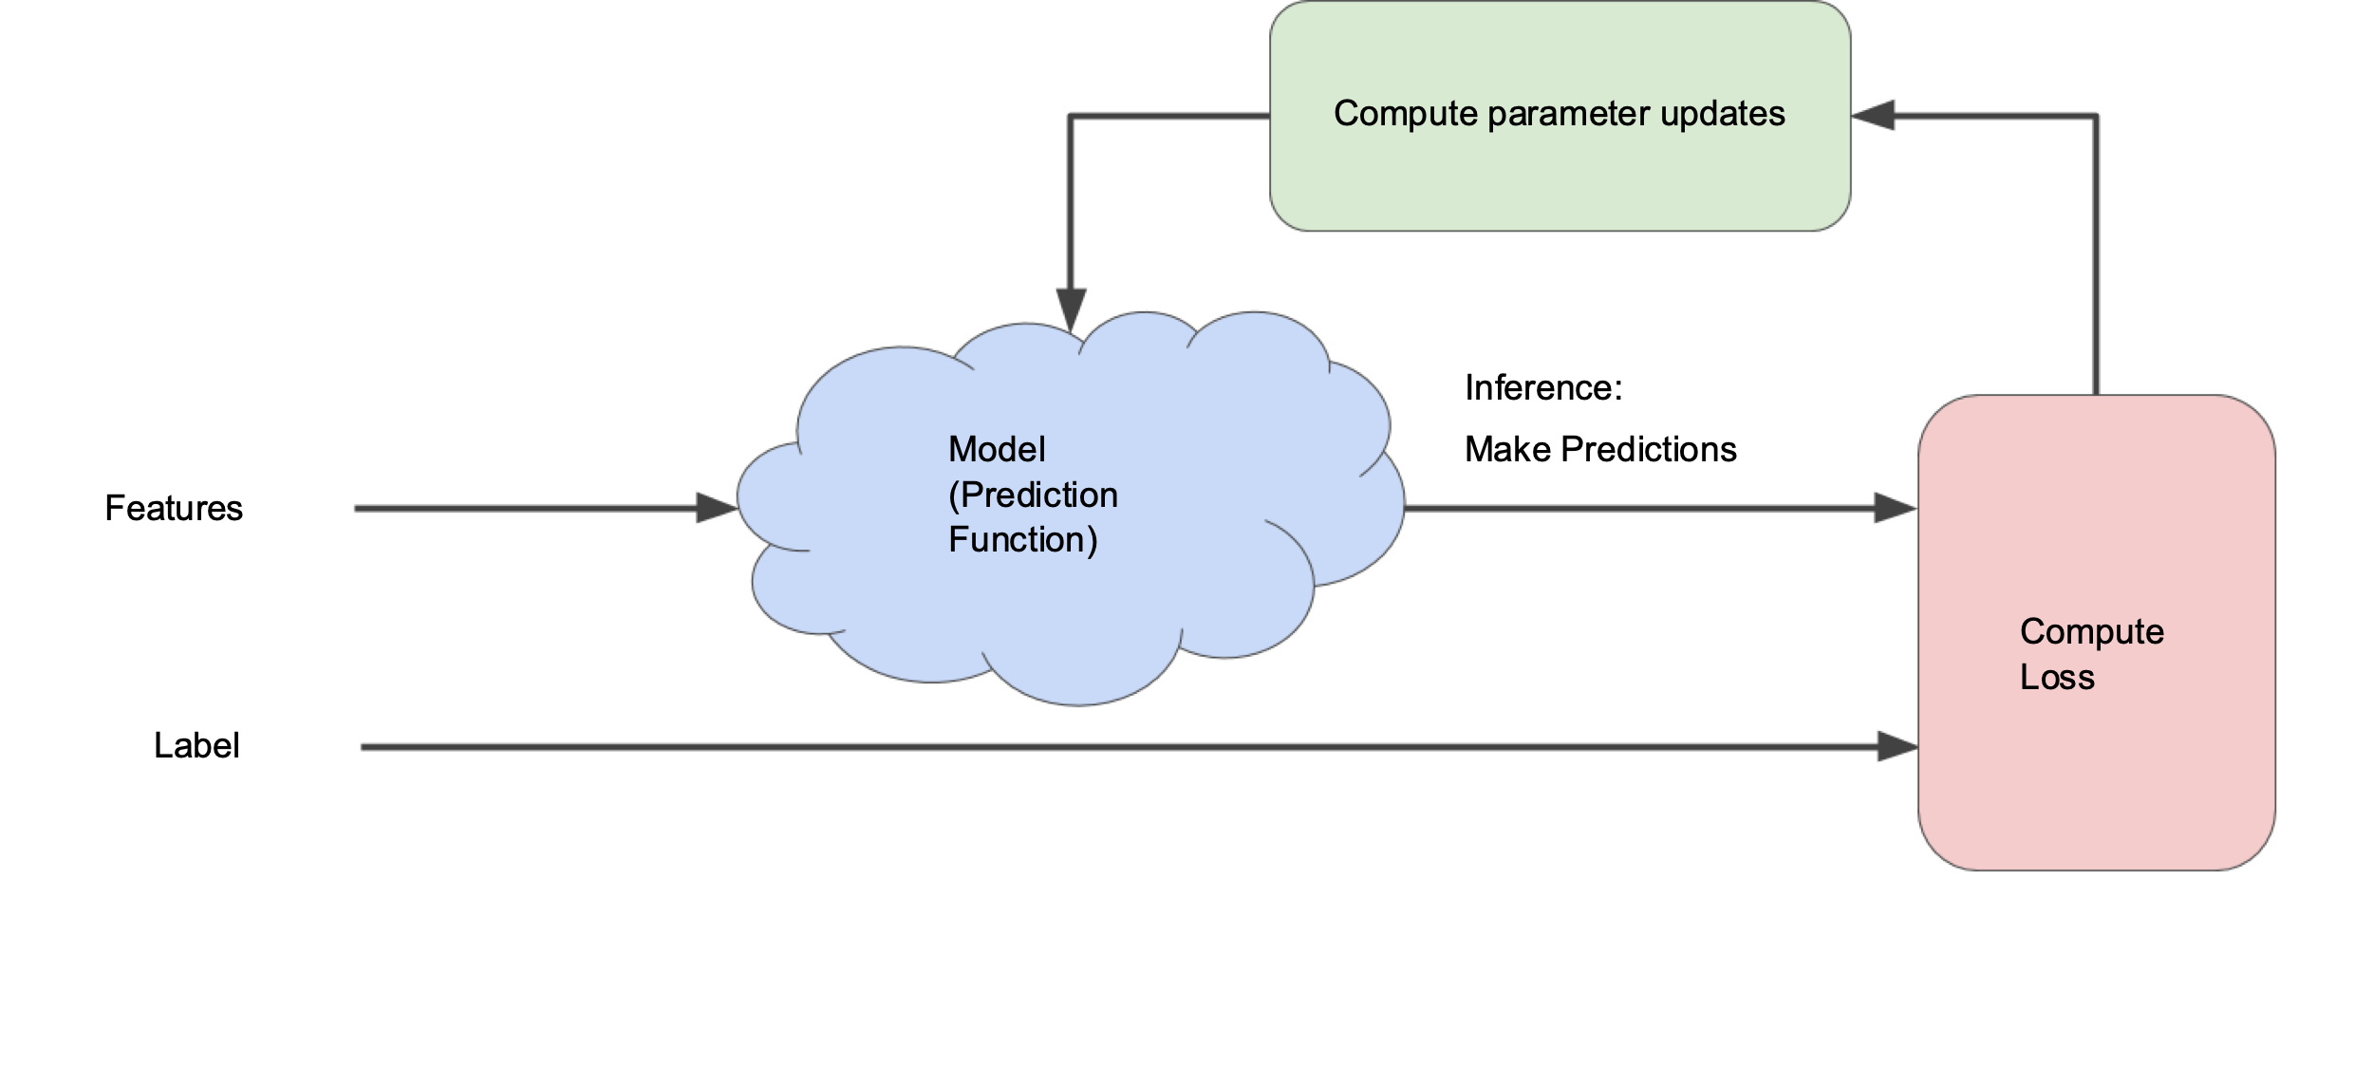
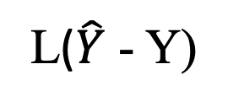

Fairy dust picture of optimization
Loss
Optimizer
parameters θ
$$\hat{Y}$$
X
Model
Loss
func.
features
predictions
Y
L($\hat{Y}$ - Y)
labels

Slide 4
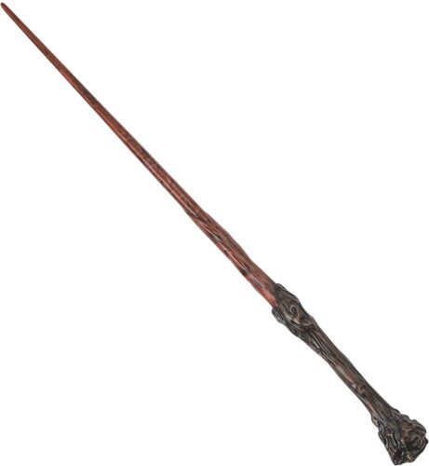
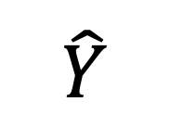
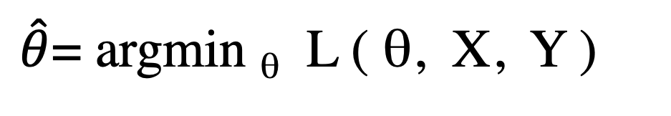
Argmin symmetries
$\hat{θ}$= argmin _{θ} L ( θ, X, Y )
This metafunction has some symmetries:
L+c has same argmin as L
cL has same argmin as L
L², abs(L), L^{1/2} same argmin
log(L) has the same argmin if L isn’t outside its domain
Loss
θ
$$\hat{Y}$$
X
Y

Slide 5
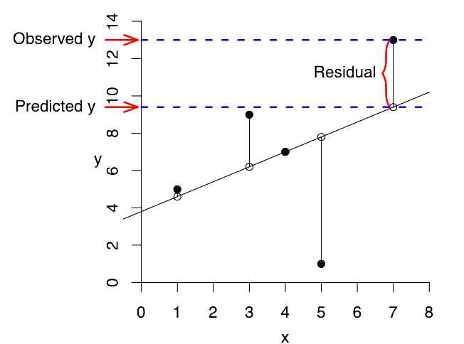
“Regression” = prediction of values
Summed squared error
SSE = Σ (ŷ_{i} - y_{i} )²

Slide 6
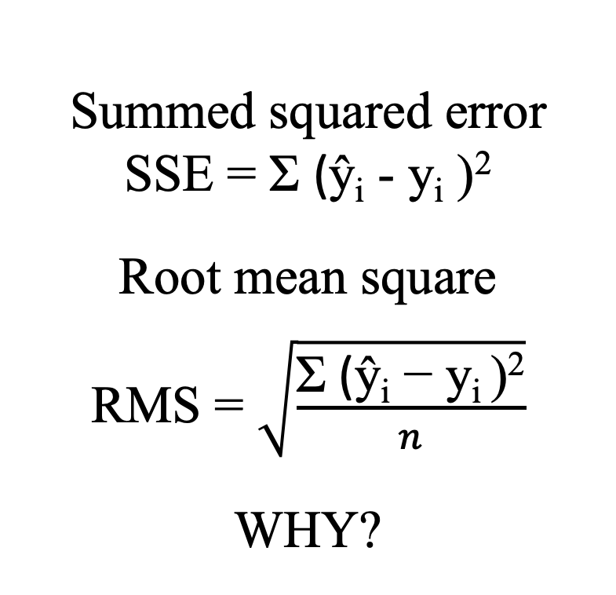
“Regression” = prediction of values
Summed squared error
SSE = Σ (ŷ_{i} - y_{i} )²
^{Root mean square}
RMS = $\sqrt{\frac{\text{Σ}\text{ (}\text{ŷ}\text{i}\text{ − }\text{yi} \text{)}\text{2}}{n}}$
^{WHY?}

Slide 7
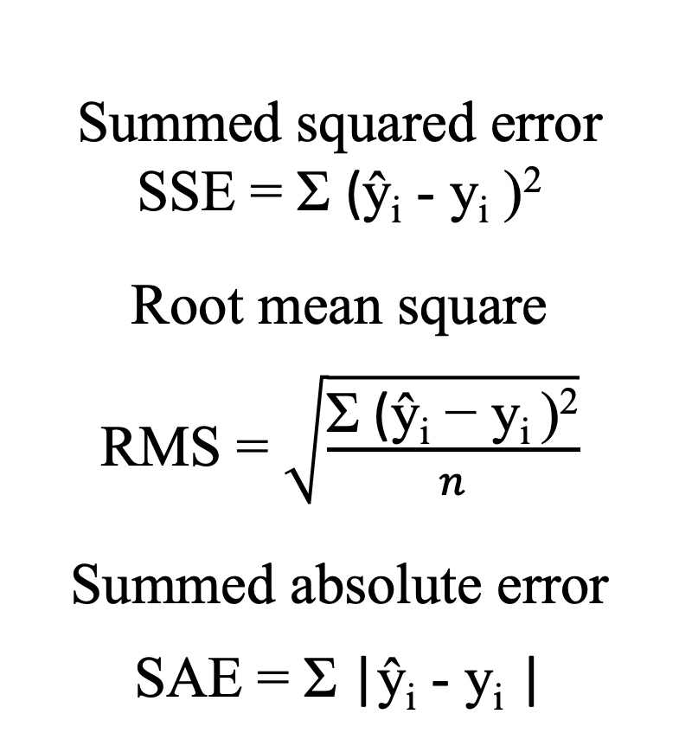
“Regression” = prediction of values
Summed squared error
SSE = Σ (ŷ_{i} - y_{i} )²
^{Root mean square}
RMS = $\sqrt{\frac{\text{Σ}\text{ (}\text{ŷ}\text{i}\text{ − }\text{yi} \text{)}\text{2}}{n}}$
^{Summed absolute error}
SAE = Σ |ŷ_{i} - y_{i} |

Slide 8
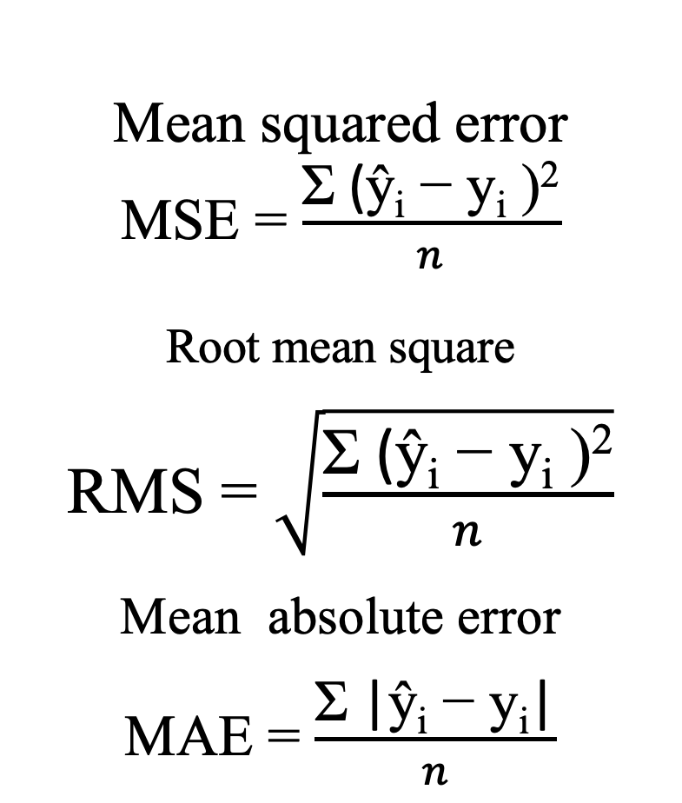
I don’t have to calculate these because of the argmin symmetries. These are monotonic functions of SSE and SAE
Mean squared error
MSE = $\frac{\text{Σ}\text{ (}\text{ŷ}\text{i}\text{ − }\text{yi}\text{ )}\text{2}}{n}$
^{Root mean square}
RMS = $\sqrt{\frac{\text{Σ}\text{ (}\text{ŷ}\text{i}\text{ − }\text{yi}\text{ )}\text{2}}{n}}$
^{Mean absolute error}
MAE = $\frac{\text{Σ} \text{|}\text{ŷ}\text{i}\text{ − }\text{yi}\text{|}}{n}$

Slide 9
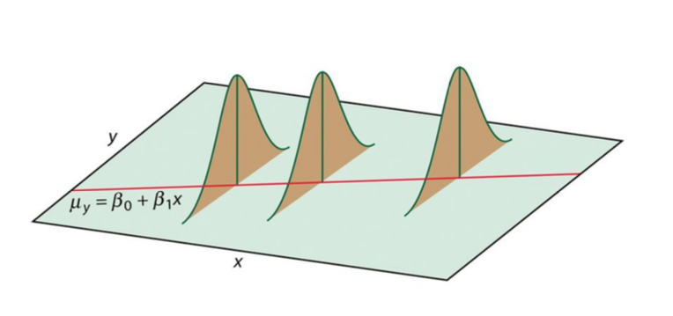
Consequences of sum-squared-error
Minimizing sum-squared error solves the problem of model + additive normally-distributed noise in y where the noise level at each point is the same.
This is often not reasonable; each point often should not get the same weight. Examples?
Weighted (per-datapoint) sums of sum-squared error relax this requirement if you have a theoretical (or empirical) reason to estimate them differently. (Standard error of the mean, anyone?)

Slide 10
Loss function sometimes implies probability
When the objective function looks like (is proportional to) a log-probability function, optimizing it looks a lot like maximum likelihood / maximum a posteriori estimation.
Sum squared errors.. are the log of additive normal error distributions
Certain regularization terms , like w^{T}w, solve the problem with as if the total probability distribution includes normal priors on the components of w. (!!!)
Nice if it’s bounded below
Discontinuities are frowned upon.

Slide 11
Objective function options : choices
The choice of function here sets the balance between small errors and large errors.
Mean Squared Error / sum squared error “L2 loss function”
penalizes large errors much more than small ones
Mean absolute error “L1 loss function”
discontinuous derivative; derivative does not vanish anywhere; all the points pull on the fit whether above or below the fit.
Constraints on parameters, parameter domain…
Cross entropy or expected – log (p)
Useful for completely blind density fitting

Slide 12
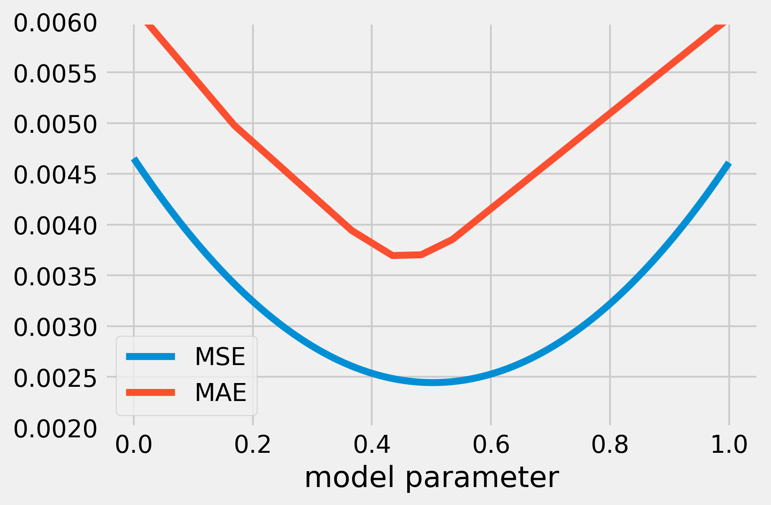
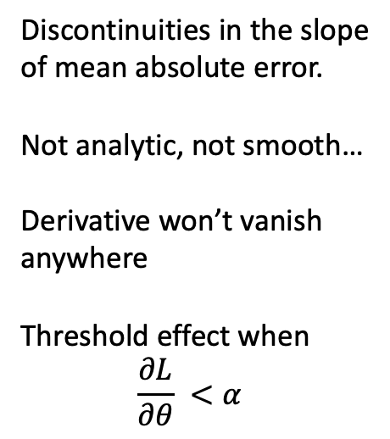
Contrast L2 and L1
Discontinuities in the slope
of mean absolute error.
Not analytic, not smooth…
Derivative won’t vanish
anywhere
Threshold effect when
$$\frac{∂L}{∂θ} <α$$

Slide 13
Contrast L2 and L1
L2 in the residuals gives the same solution as optimizing additive normally distributed errors.
L1 in the residuals give the same solution as optimizing Laplace-distributed errors.
But we can add terms to the loss function that don’t correspond to probability distributions.. these will steer the solution around..

Slide 14
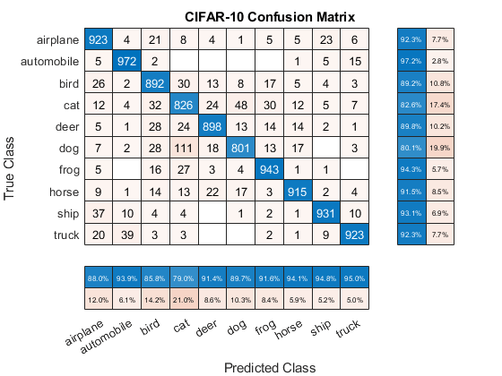
Loss functions for categorical data:
“Accuracy” -- number of correct assignments on the test set
Makes sense to assign penalties to each wrong answer. They can be all the same or they can be different.

Slide 15
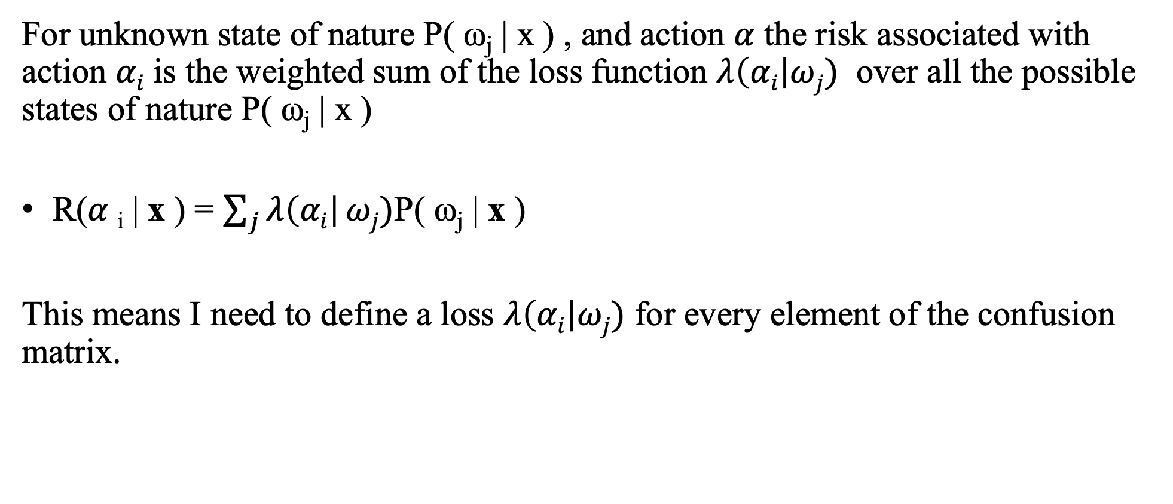
Expected loss
For unknown state of nature $\text{P}\text{( }\text{ωj}\text{ | }\text{x}\text{ )}$ , and action $α$ the risk associated with action $αi$ is the weighted sum of the loss function $λ\left(αi\right|ωj)$ over all the possible states of nature $\text{P}\text{( }\text{ωj}\text{ | }\text{x}\text{ )}$
R($α$_{i} | x ) = $\sum_{j}{λ\left(αi\right|}ωj)\text{P}\text{( }\text{ωj}\text{ | }\text{x}\text{ )}$
This means I need to define a loss $λ\left(αi\right|ωj)$ for every element of the confusion matrix.

Slide 16
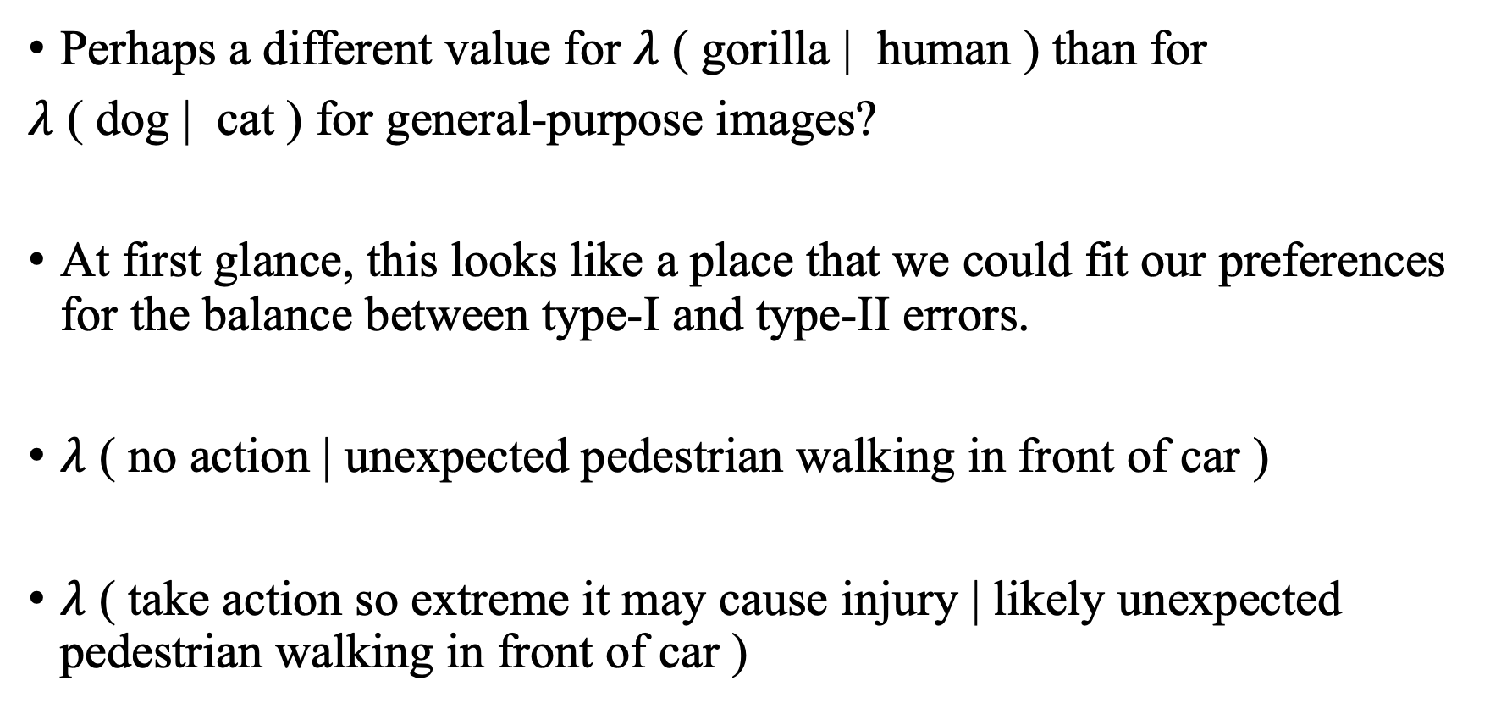
Thoughts on the loss
Perhaps a different value for $λ$ ( gorilla | human ) than for
$λ$ ( dog | cat ) for general-purpose images?
At first glance, this looks like a place that we could fit our preferences for the balance between type-I and type-II errors.
$λ$ ( no action | unexpected pedestrian walking in front of car )
$λ$ ( take action so extreme it may cause injury | likely unexpected pedestrian walking in front of car )

Slide 17
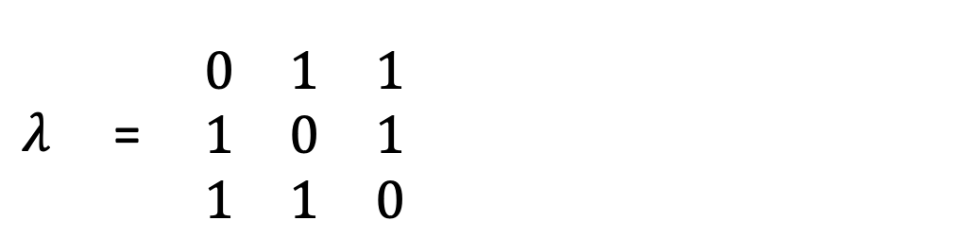
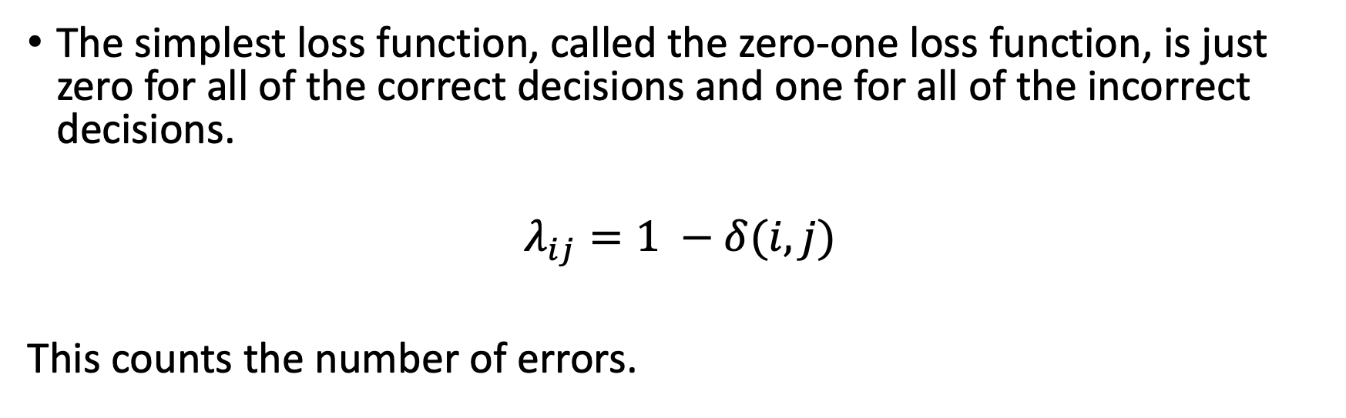
Zero-one loss function
The simplest loss function, called the zero-one loss function, is just zero for all of the correct decisions and one for all of the incorrect decisions.
$$λ_{ij}=1 −δ(i, j)$$
This counts the number of errors.
$λ$ = $\begin{matrix}0 & 1 & 1 \\ 1 & 0 & 1 \\ 1 & 1 & 0\end{matrix}$

Slide 18
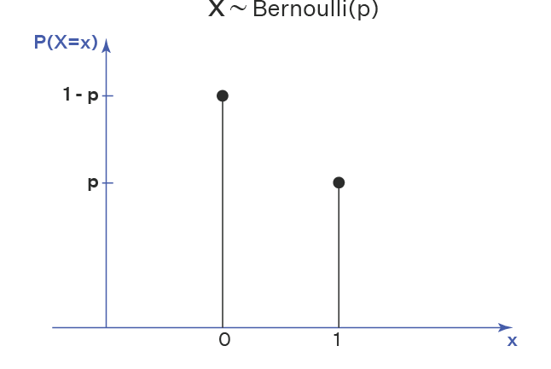
How about the domains?
When estimating probabilities (like mixing ratios) some parameters naturally live in the parameter space of the Bernoulli (or multinomial / categorical distribution)
That is to say, there are a lot of useful parameters out there that are between 0 and 1.
How do we search a space without running out of the domain?
Loss ( min( max(0, x ), 1) ) is not a good choice.
Loss_{CONSTRAINED} = Loss + HUGE ( x> 1) + HUGE ( x < 0)
also not a good choice

Slide 19
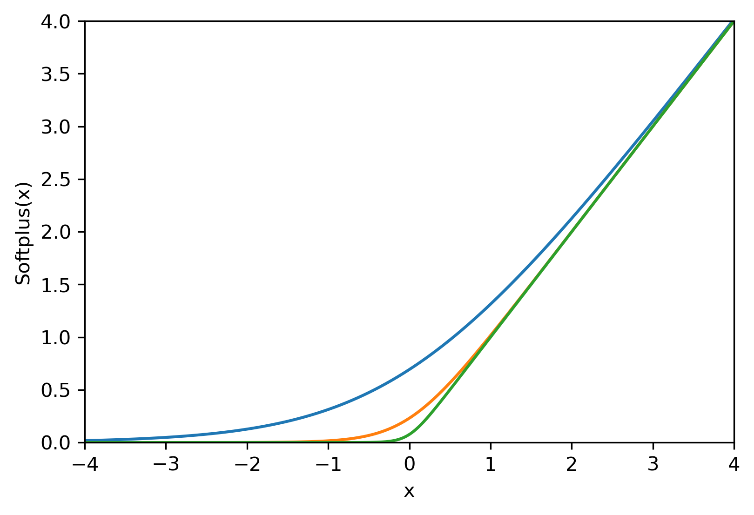

Softplus
$$softplus\left(x\right)=\log\left( 1+\exp\left(x\right)\right)$$
gentler form of max(0, x)

Slide 20
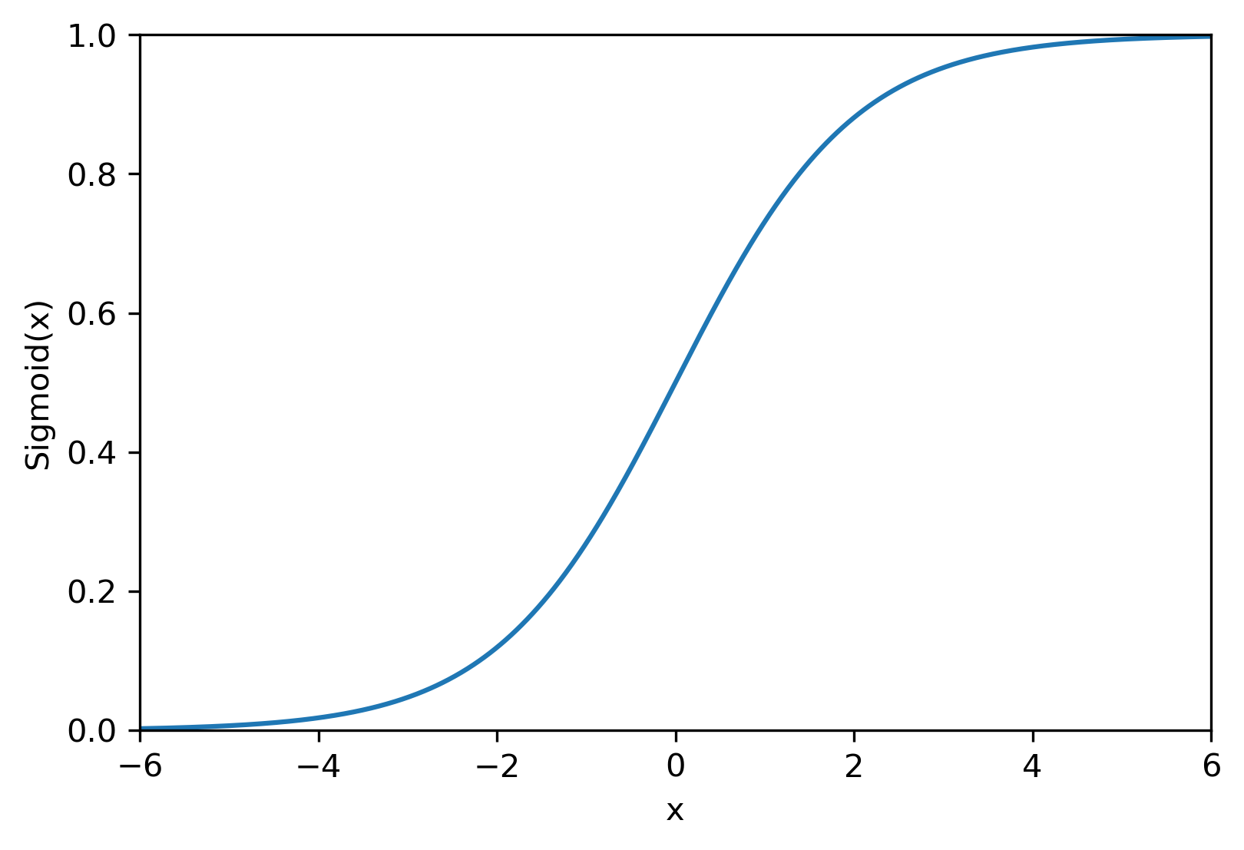
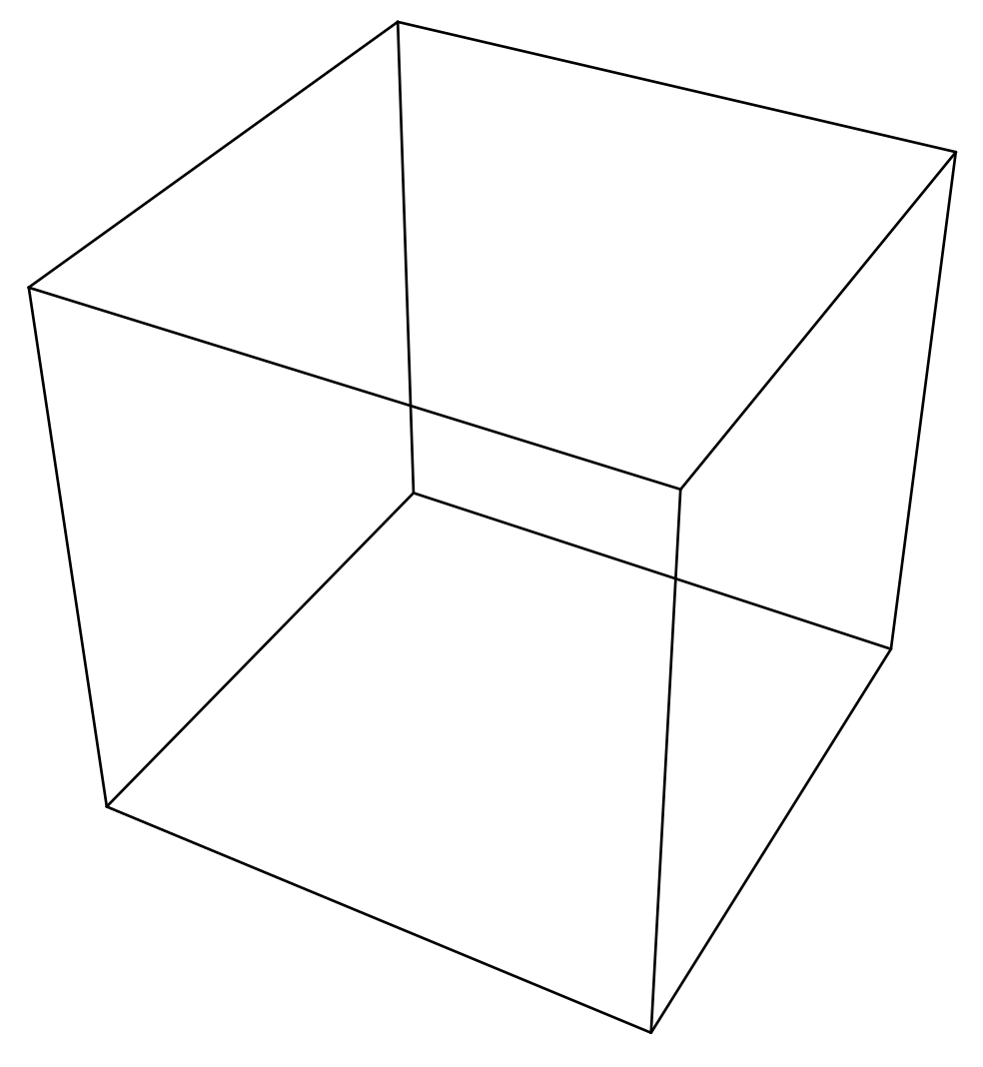

Sigmoid function
$$sigmoid\left(x\right)=\frac{exp\left(x\right)}{1+\exp\left(x\right)}{ }$$
gentler form of 0.5* sign(x) + 0.5
continuous mapping from ℝ to (0,1)
ℝ³ -> 1³

Slide 21
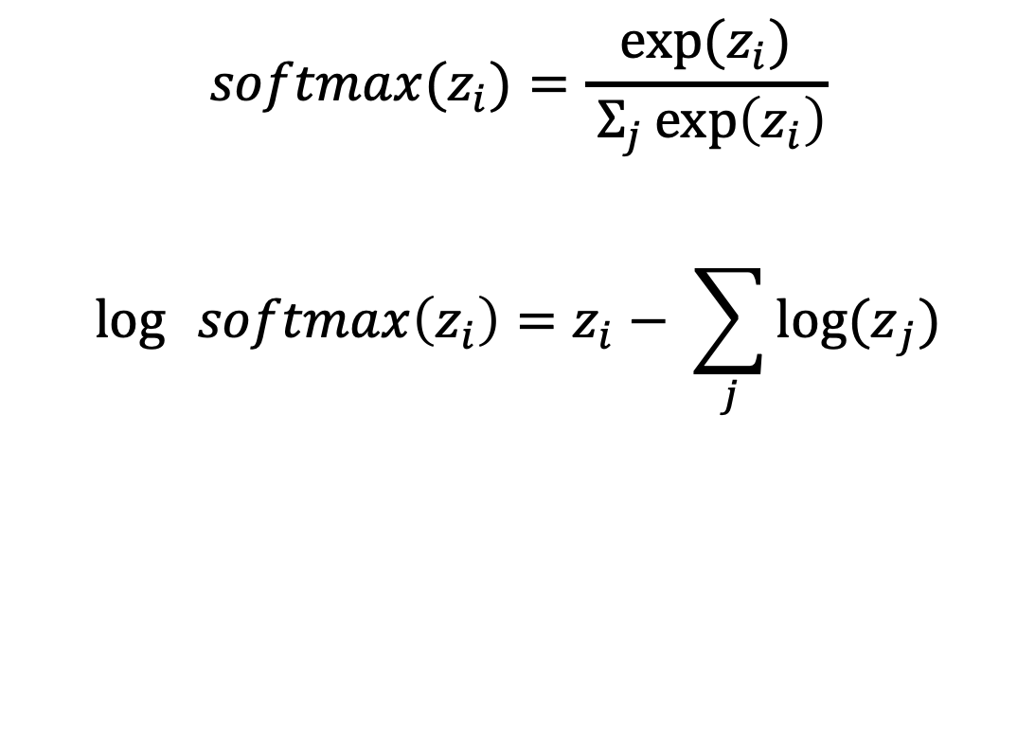
Softmax
$$softmax(z_{i})=\frac{{exp⁡(z}_{i})}{ Σ_{j}\exp\left(z_{i}\right)}$$
$$\log{ }softmax\left(z_{i}\right)=z_{i}− \sum_{j}{{log⁡(z}_{j})}$$

Slide 22
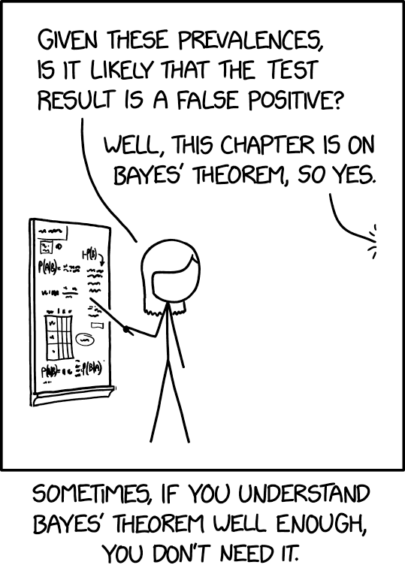
In favorable cases, we can use Bayes’ theorem to estimate our parameters. In less favorable cases, we can do a randomized search for possible parameter values.

Slide 23
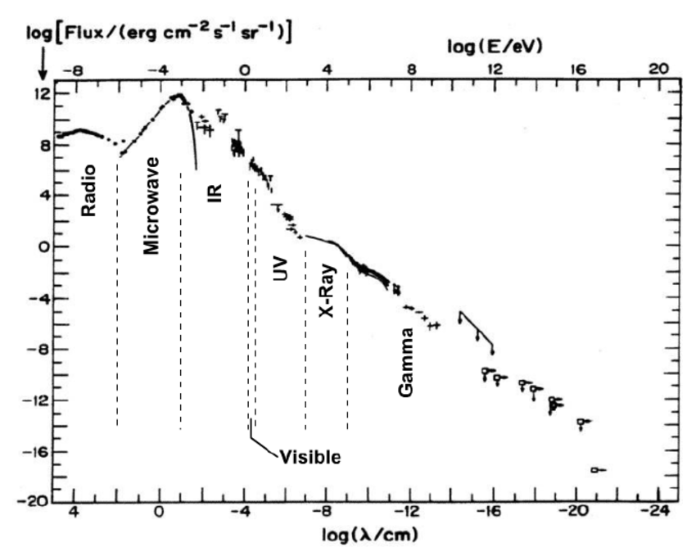
Why do we take logs?

Slide 24
Why do we take logs?
Mathematical convenience; turns multiplication into addition
Dynamic range; floating points only store 15 digits (Anyone tried to calculate 500 Choose 498 on a calculator?)
Numerical precision: probabilities in high-dimensional space run into underflow problems
log-transform is monotonic,
so the location of the optimum
is unperturbed

Slide 25
Bayesian inference
Event A: unknown state of nature
Event C: experiment
P(A | C ) = P(C|A) P(A) / P(C)
A
C
A∩C

Slide 26
Bayesian inference
Event A: unknown state of nature
Event C: experiment
P(A | C ) = P(C|A) P(A) / P(C)
A
C
“Numerical decisionmaking for grownups”
A∩C

Slide 27
Bayesian inference
Event A: am I infected?
Event C: experiment (test result)
P(A | C ) = P(C|A) P(A) / P(C)
The thing
I want to
know
The thing
the FDA wants
know
C
A
A∩C

Slide 28
Bayesian inference
Event A: unknown state of nature
Event C: experiment
P(A | C ) = P(C|A) P(A) / P(C)
Term with
knowledge
and bias
about A
prior
A
C
Life’s persistent
question
Term that
depends on
experiment
likelihood
Probability
for event that is no longer uncertain
evidence
A∩C

Slide 29
Bayesian inference
Event A: value of parameter
Event C: data
P(A | C ) = P(C|A) P(A) / P(C)
Desired
distribution/
parameter value
posterior
Prior
distribution
for parameter
prior
Doesn’t
matter for
us
evidence
A
C
This is the
likelihood
A∩C

Slide 30
Log ( Bayesian inference)
Event A: unknown parameter
Event C: data
log P(A | C ) = log P(C|A) + log P(A) – log P(C)
Desired
parameter distribution
The likelihood
likelihood
Prior distribution
on the parameter
prior
depends only on the data
evidence
posterior
likelihood

Slide 31
Bayesian inference
θ: value of parameter
Y: data
P( θ | Y ) = P(Y|θ) P(θ) / P(Y)
Distribution
to help me
find the
parameter value
posterior
This is the
likelihood
likelihood
Doesn’t
matter for
us
evidence
A
Y
Prior
distribution
for parameter
prior
A∩Y

Slide 32
Bayesian inference for sequential
θ: value of parameter
Y: data
P( θ | {Y_{i}} ) = 𝚷P_{i}(Y|θ) P(θ)
likelihood
posterior
prior
A
Y
Posterior density
Product of likelihoods of independent observations
One factor of the prior on the parameter
A∩Y

Slide 33
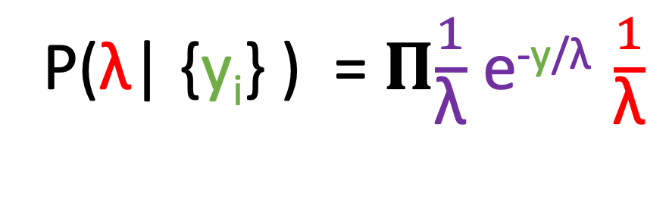
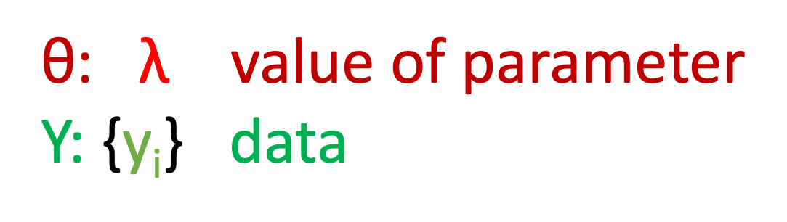
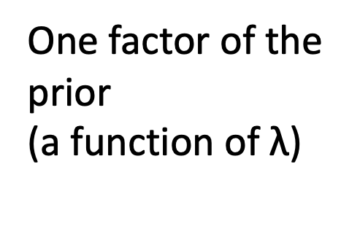
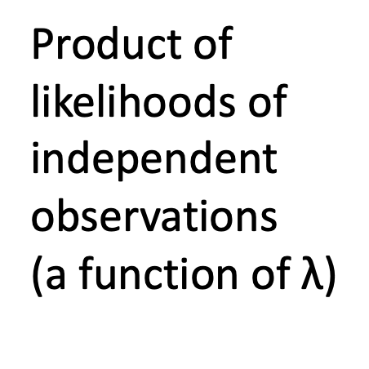
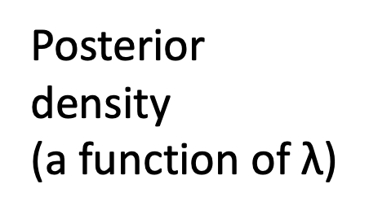
Sequential Bayesian inference for continuous parameters: MacKay’s example
θ: $\text{λ}$ value of parameter
Y: {y_{i}} data
P($\text{λ}$| {y_{i}} ) = 𝚷$\frac{1}{\text{λ}}$ e^{-y/}$\text{λ} \frac{1}{\text{λ}}$
likelihood
posterior
Product of likelihoods of independent observations
(a function of $\text{λ}$)
prior
Posterior density
(a function of $\text{λ}$)
One factor of the prior
(a function of $\text{λ}$)

Slide 34
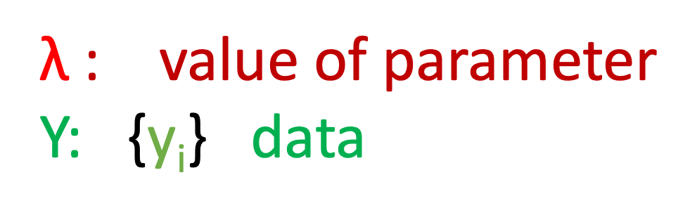
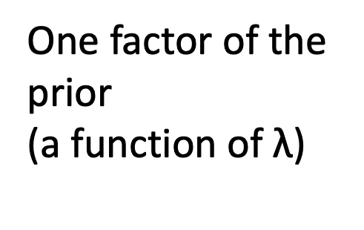
Typical setup for ML interpreted as inference
$\text{λ}$: value of parameter
Y: {y_{i}} data
log P($\text{λ}$| {y_{i}} ) = $\text{Σ}\text{LL}\text{(}$y,$\text{λ}$) $+ regularization term(\text{λ}$)
likelihood
posterior
Sum of log- likelihoods of independent observations
prior
Posterior density
One factor of the prior
(a function of $\text{λ}$)

Slide 35
Where does the prior come from?
In some cases, there will be a correspondence between our objective function and the solution to a Bayesian inference problem.
If we were doing this the other way, taking inference as our approach to problem-solving, we would choose prior distributions either from
Prior research into the values of the parameters (common in physical sciences)
Symmetries of the problem (geometry) that makes certain classes of solution equivalent to certain other classes of solution.
Some of these priors don’t have finite integrals… “improper priors” usually the likelihood forces the product to converge; if it doesn’t, we have to take the limit of a ratio of divergent integrals.
Sometimes, the priors are chosen because they are easy to calculate
(good and bad)

Slide 36
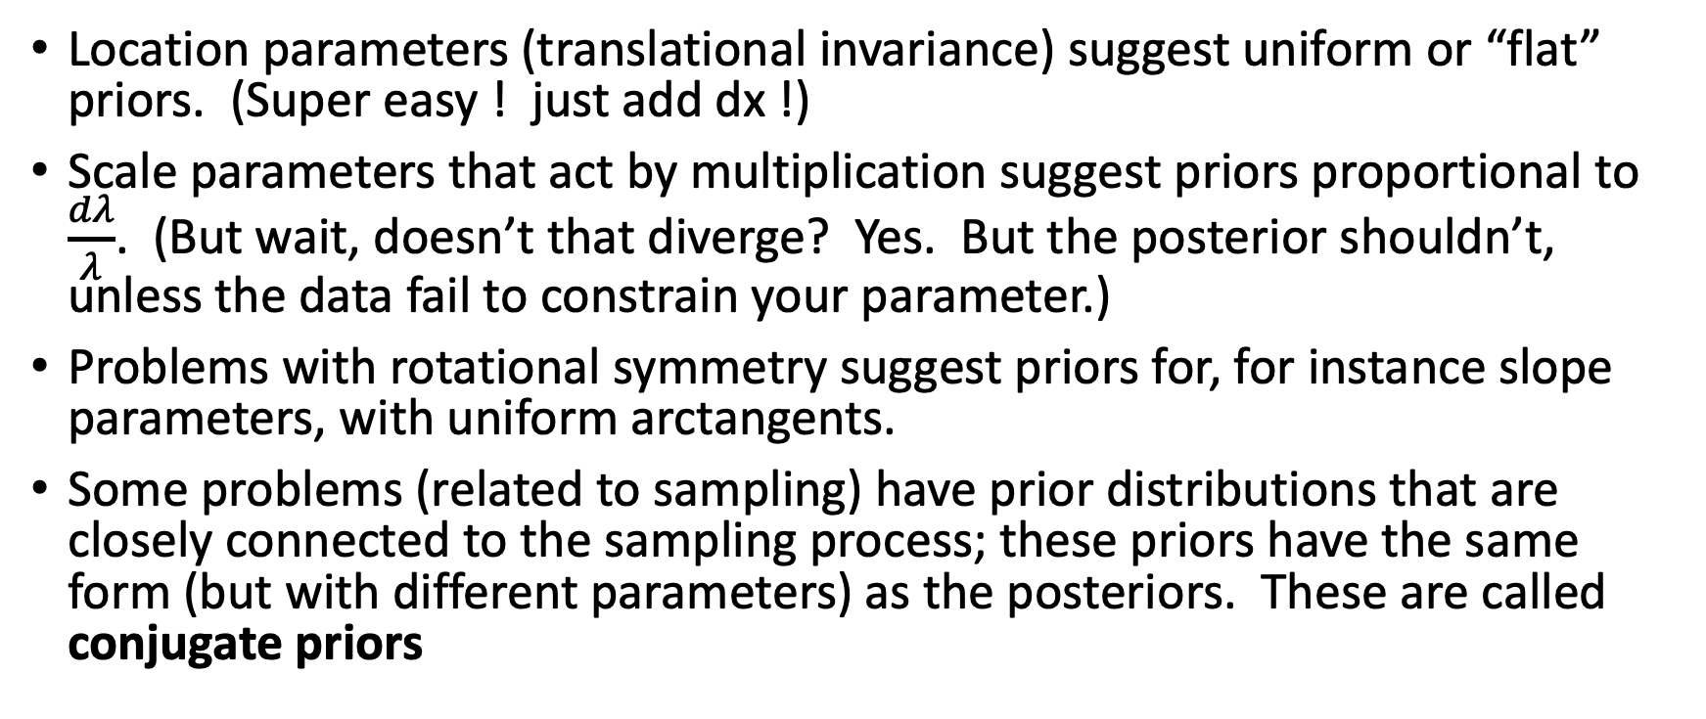
Choices
Location parameters (translational invariance) suggest uniform or “flat” priors. (Super easy ! just add dx !)
Scale parameters that act by multiplication suggest priors proportional to $\frac{dλ}{λ}$. (But wait, doesn’t that diverge? Yes. But the posterior shouldn’t, unless the data fail to constrain your parameter.)
Problems with rotational symmetry suggest priors for, for instance slope parameters, with uniform arctangents.
Some problems (related to sampling) have prior distributions that are closely connected to the sampling process; these priors have the same form (but with different parameters) as the posteriors. These are called conjugate priors

Slide 37
Homework guidelines
No particular tools are required (python, R, javascript..) but we’re better able to help you in python and R.
Graphs are expected to a medium-high standard. Labels, units everywhere where needed. Caption-like explanations of graphs preferred.
Graphs for projects must be much, much better; expect to adjust the font size on everything that has writing.
Upload answers to canvas. Separately upload code (to a low standard) that you used to solve the homework. We probably won’t look at the code.
Unevaluated code can’t be marked.

Slide 38
Office Hours
WT: 1st week Friday 2-3:30
2nd week Wednesday 12:30-2:00
Friday 12:30-2:00
Poll?

